Slide 1
Indirect Rate Strategies: How To Budget for Success!
October 17, 2023

Slide 2
Today’s presenter
Donna Dominguez Government Contract Compliance Leader & Advisory Partner, Aprio
Donna has more than 20 years of experience providing a wide range of financial compliance advisory services to government contractors. She is experienced in matters related to FAR, CAS, ICS, DCAA cognizant audit support, provisional billing rates, establishing or revising indirect rate structures, and cost proposal support.
Donna works with government contractors to help them grow their businesses while keeping their accounting systems adequate and their billing systems current and relevant. She is also involved in supporting the government contracting community as a frequent guest speaker and author on a variety of compliance topics.
LinkedIn

Slide 3
Today’s presenter
Tram Vo Senior Manager, Government Contracting, Aprio
Tram Vo is a Senior Manager in Aprio LLP’s Government Contracting Services Group with 15+ years of experience and knowledge of Federal Acquisition Regulations (FAR). Tram began her career with the Defense Contract Audit Agency (DCAA) working with contractors on Incurred Cost Submission audits, Forward Pricing Proposals, Defective Pricing, Cost Accounting Standard Review, Floor checks and more.
She also has experience with both small and large contractors and understands the critical compliance issues and needs for each. She has extensive experience with monthly accounting & billings, provisional bill rates, adequate accounting systems, estimating systems and contract administration.
LinkedIn

Slide 4
How to Earn CPE Credits
We are using Zoom as the learning webinar platform.
To earn full CPE credit for this course, you must answer at least three out of the four of the polling questions.
You will receive credit if you answer the polls, not whether you get them correct.

Slide 5
Learning Objectives
Participants will
Recall how to develop competitive budgeted indirect rates and structure

Slide 6
Discussion Agenda
Top 5 Reasons for Budgeted Indirect Rates
Pricing Strategies
How to Budget
Q&A

Slide 7
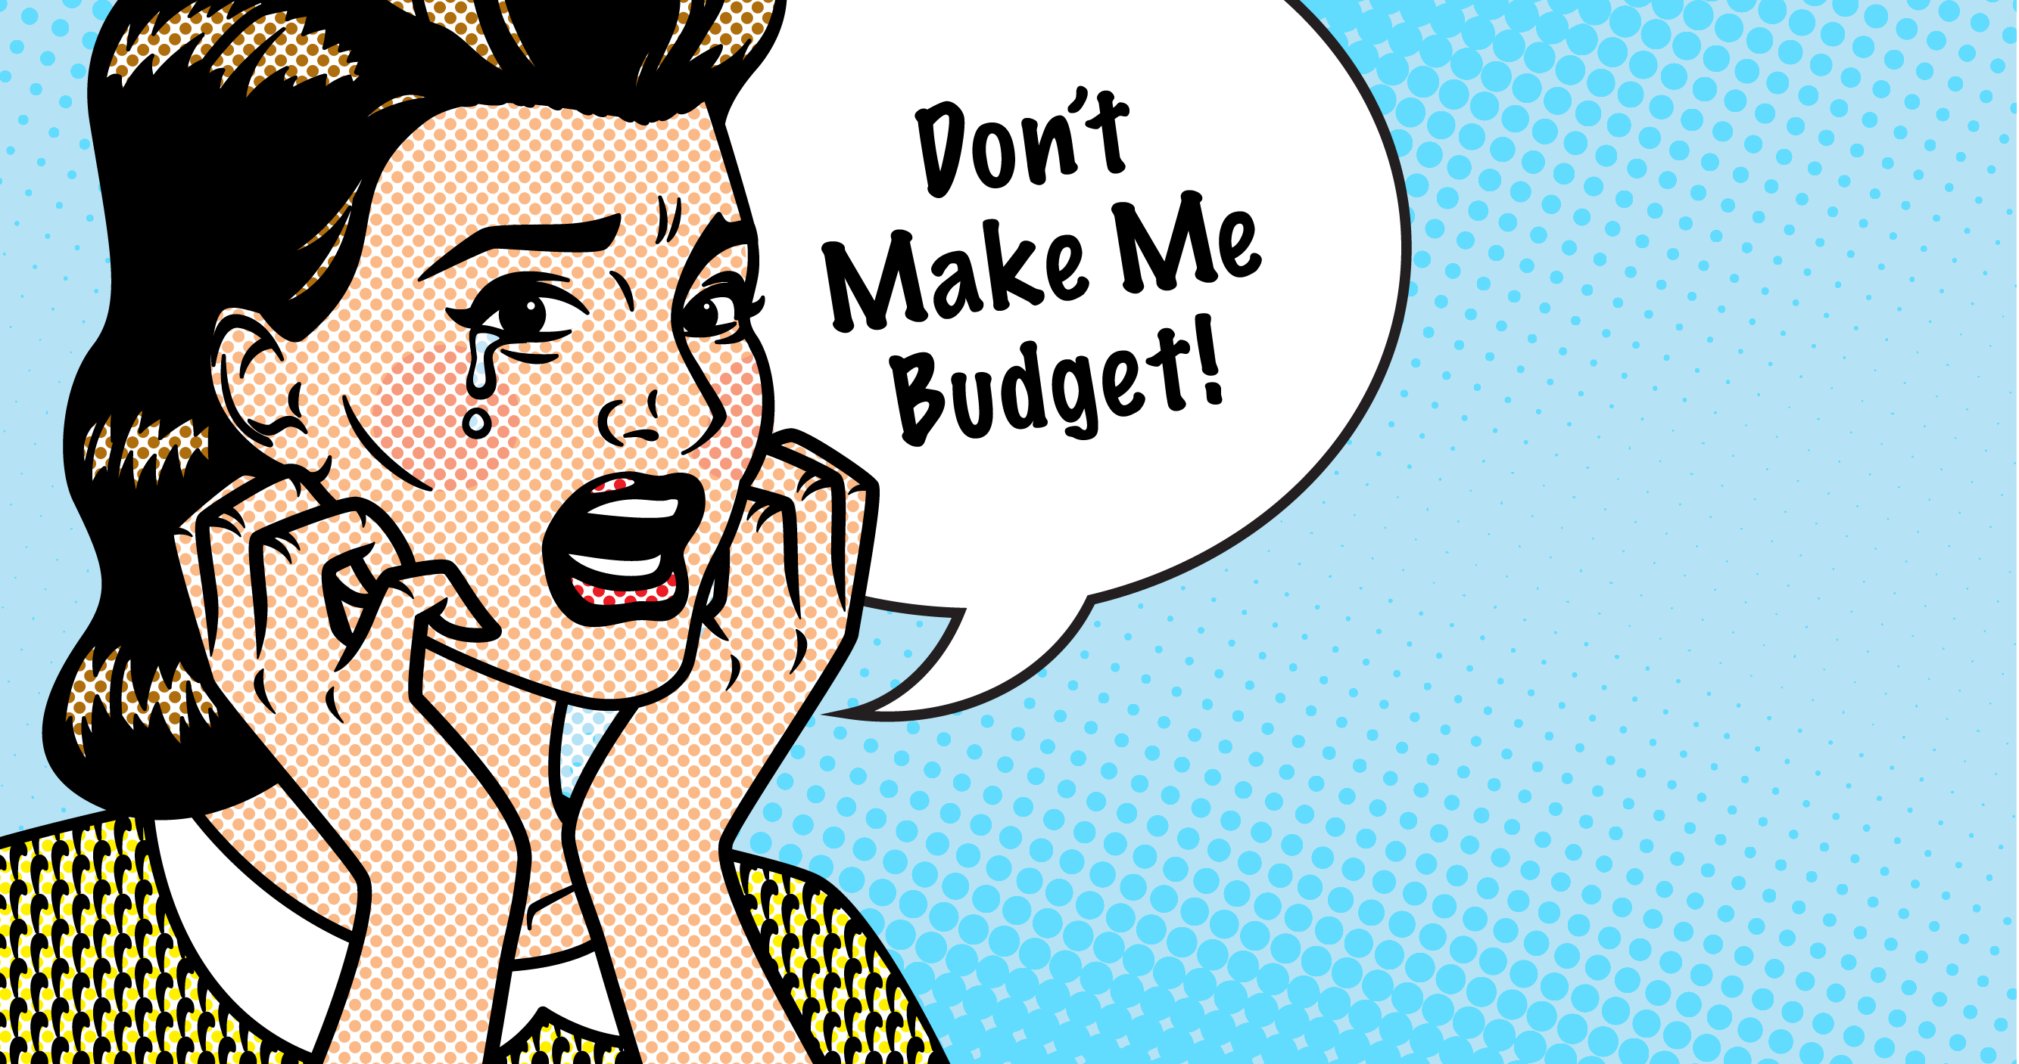

Slide 8
The 5 W’s of Budget Rates & Rate Structures
Who should prepare budgeted rates and evaluate their rate structures? – All Government Contractors whether required by contract or not.
Why do I need to prepare my budgeted rates? – In order to establish your provisional billing rates for invoicing and for cost build up on cost proposals. Why do I care about my indirect rate structure? – So that you can ensure your business is staying competitive in the market.
What is the purpose of establishing provisional billing rates? – It allows you to invoice on flexibly priced contracts at budget rates before you true up to actuals. It also helps to measure performance and profitability on Fixed Price (FP) and Fixed Labor Hour (FLH) contracts.
When do I need to prepare my budget and evaluate my rate structure? – At a minimum once a year for both.
Where do I submit my provisional rates? It depends whether it’s for yourself, the contracting officer, or the cognizant Federal agency official. For those that have Disclosure Statements (D/S), if you revise your rate structure, you will have to submit your revised D/S to DCMA.

Slide 9
Top 5 Reasons for Budgeted Indirect Rates

Slide 10
CPE Question 1
Have you ever submitted budgeted rates for compliance with your contracts?
Yes
No

Slide 11
Top Reasons Why You would Prepare an Indirect Rate Budget
Contractual requirements (FAR 52.216-7(e) Allowable Cost & Payment Clause & Subpart 42.7)
Evaluating your business for future goals and strategies
To be compliant with your
estimating system
To budget/adjust costs for growth, acquisitions or loss
Using budget rates for proposals and invoicing

Slide 12
Budgeting Indirect Rate (while trying to stay competitive!)
%
Finding the right balance between existing work with future contracts, all while still being competitive and profitable is a difficult balancing act.

Slide 13
Indirect Rate Strategies
How do you know what is the right rate structure
for you?
How many Overheads should I have?
What is a reasonable
G&A rate?
When do I need
an SM&H Rate?
Is it a good time to restructure after acquisition?

Slide 14
Indirect Rate Strategies
Two Key Things to Remember
1
2
Your cost are your costs.
When one rate goes down, another will go up.

Slide 15
Things to Consider When Preparing your Budget Rates
Understand your business
What products/services do you offer?
How are you different from competitors?
What are customers telling you?
What does your win/loss history reveal?
What is your contract and customer mix?
How do labor limit and costs set by Prime Contractors factor into your cost structure?

Slide 16
CPE Question 2
What is the current contract mix at your company? Select all that apply.
Majority Cost Type
Majority T&M
Majority Fixed Price

Slide 17
Steps to Begin the Budgeting and Rate Structure Process:
Once you have your historical costs and a baseline understanding of the company’s strategic goals and target wrap rate, begin building your budgeted rates.
Review costs in each pool, service centers, allocation basis, and new items. Are the costs on a causal / beneficial relationship?
Do I have different lines of business or locations that require difference in cost?
Have we had any acquisitions that I now need to consider into our overall rate structure?

Slide 18
Steps to Begin the Budgeting and Rate Structure Process:
Begin preparing different rate structures until you get to the one that is closest to your goals.
Review the impact to your existing contract mix. How does this effect our profitability on FP and T&M contracts?
Review internally and submit to ACO/CO & DCAA or Cognizant Audit Agency.
Implement new provisional billing rates into your system and begin billing.

Slide 19
Pricing Strategies
Discounts, Impacted Rates & TCI vs. Value Add G&A Base

Slide 20
What is it? When Should I provide a Discount?
When your budgeted G&A Rate is high and not competitive on a particular proposal, you can offer a one time self imposed capped/discounted G&A Rate
It can be limited to Subcontractors/Consultants or Materials or Travel Costs only.
For bidding and pricing strategy would be to discount the G&A on the subs when you have a TCI (Total Cost Input) G&A base
This means you are self imposing a ceiling on your G&A rate for that award when you bill your subcontractor costs
You can offer discounted G&A rate on any pass-through item or cost. You reduce your profits!

Slide 21
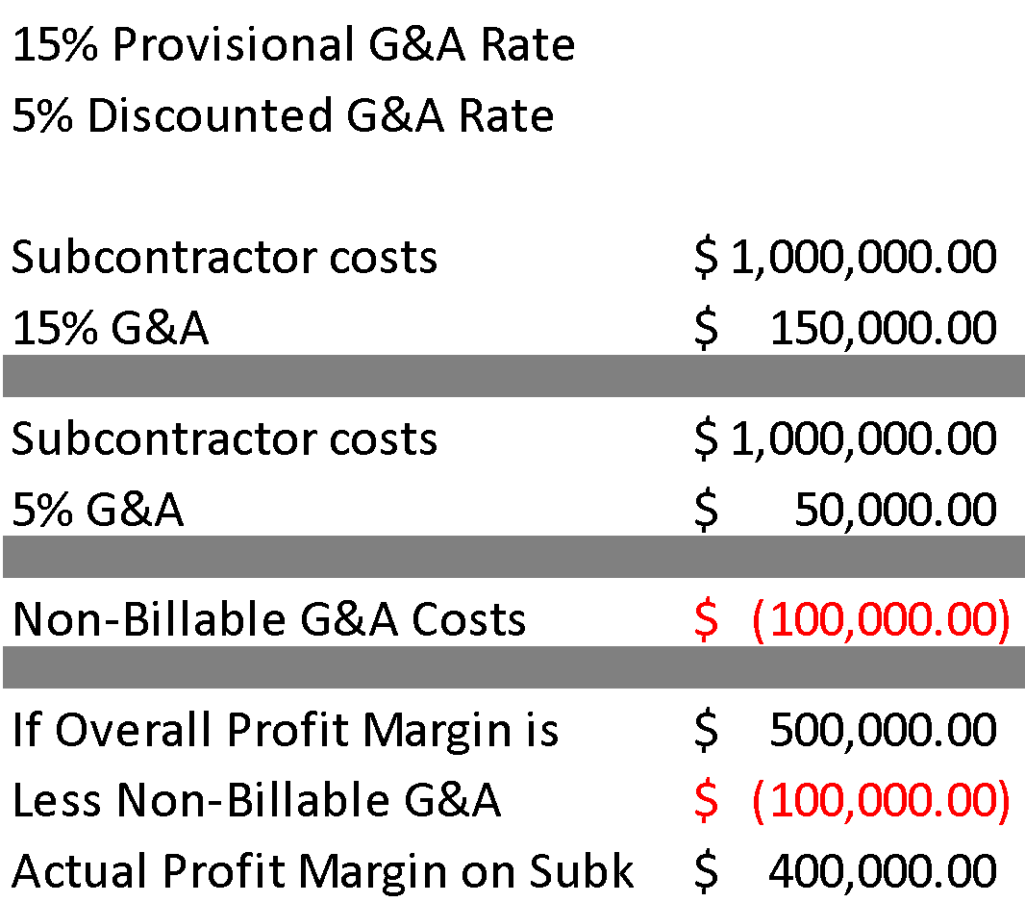
Discounted rate(s) Continued
Offering discounts does not alleviate the costs allocated to the project. Discounts reduce the overall profitability of the contract.
Calculate non-billable costs to make good business decisions.

Slide 22
CPE Question 3
Have you ever proposed discounted rates in a cost proposal?
Yes
No

Slide 23
Impacted G&A
Begin with your original budgeted indirect rates and impact or update for this one effort/RFP. Since the original budget did not include such a large effort, we now need to impact the original budget to reflect the appropriate impacts on the business should you win this award.
This can be increased direct costs
This can be increased indirect costs
This could even include different indirect rates
To not include would mean you are not considering all the costs that would impact your quote.
This often means you will have lower bidding rates!

Slide 24
Value Add G&A Base vs. Total Cost Input
Total Cost Input G&A Base
is all direct costs before
B&P and IR&D.
Value Add G&A Base is all direct costs before B&P, IR&D, Subcontractors, Consultants and Material costs.
Subcontract & Material Handling (SM&H)
Subcontract Handling (SH)
Material Handling (MH)

Slide 25
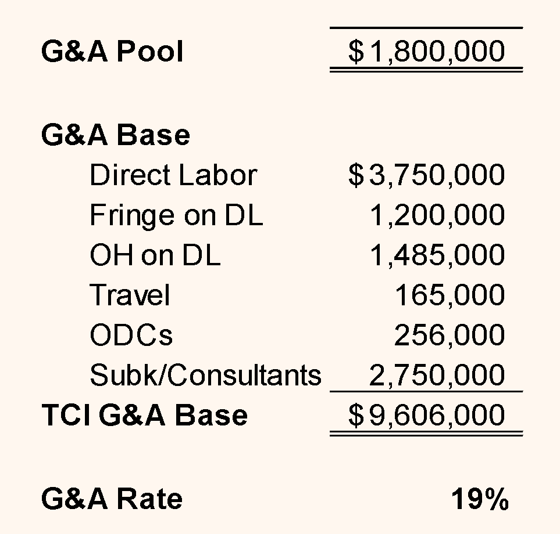
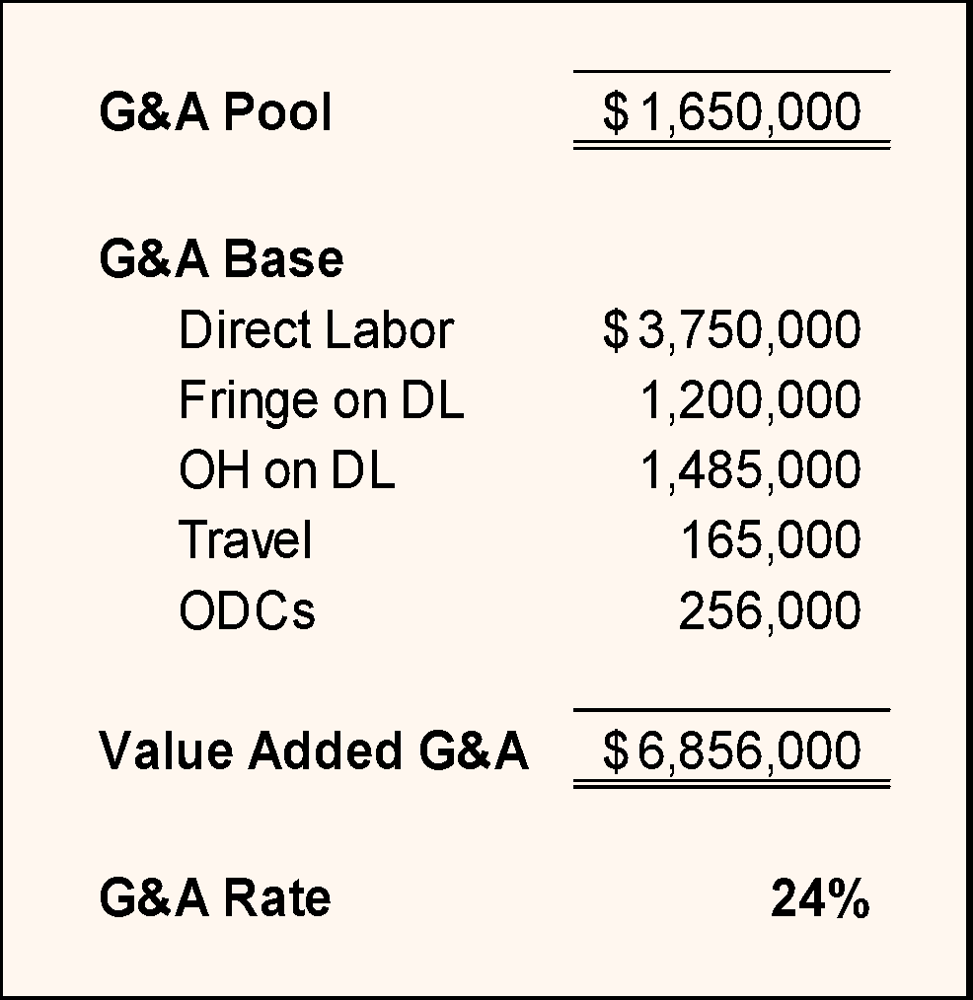
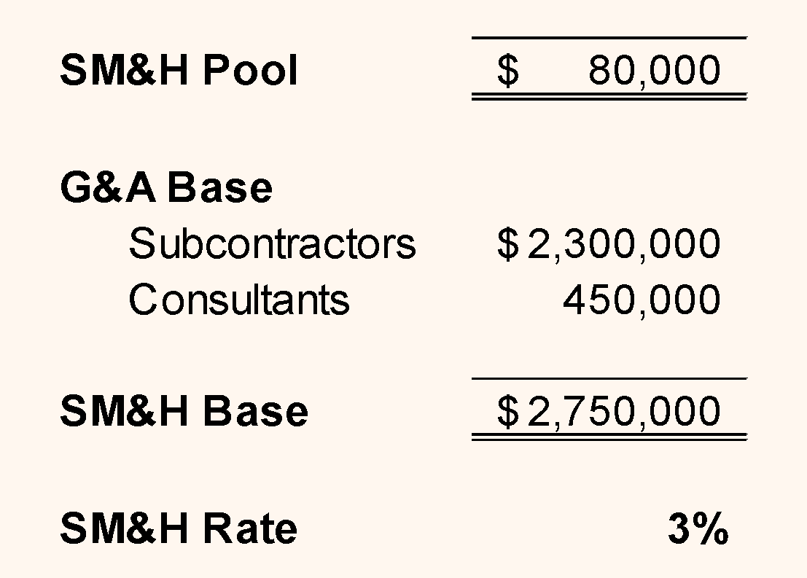
TCI vs. Value Add G&A Base

Slide 26
Unpopulated Joint Venture (JV)
G&A for the JV is derived from the G&A pool costs
from some or all of the members of the JV.
Joint Venture’s G&A Rate has a different rate than your entity and
likely G&A pool costs coming out of your entity for the JV.
Typically, 2% to 4% for JVs (Common are mentor protégé).

Slide 27
How to budget

Slide 28
Tips for Rate Structures
Think ‘Service Centers’
How are you allocating your service center?
For companies where people wear many hats (think Labor Hours), Second preference might be Labor Dollars. Costs must be allocated on a causal/beneficial relationship.
Commons SVCs (Facility or multiple Facility, IT/MIS, Contracts, etc.)
How do you handle working from home?
Does it have a material impact on the allocation?
Make a decision and be consistent.

Slide 29
Tips for Rate Structures
Review your Indirect Cost Pools
Look at what costs are going in the G&A Pool – what can be reclassified? Business Development (BD) to G&A vs. Bid & Proposal (B&P) for Overhead and Direct Personnel.
Payroll costs is this G&A or can this go in the Fringe Pool?
Training and education is this all for G&A?
Human Resources, can this be allocated to everyone like IT?
Who is charging to G&A and is that correct?
BD time for Overhead personnel – where are you booking those costs?

Slide 30
Tips for Rate Structures
Review your Indirect Cost Pools
Performance based bonus dollars – Follow the labor or in the fringe pool?
Recruiting Costs – Follow the labor. This will likely lead to most of the cost in the Overhead Pool(s).
Be consistent when applying like costs. Office supplies and Facility Service Center (CAS 401)
You have a great system, LEVERAGE IT!

Slide 31
Tips for Rate Structures
Review your Indirect Rate Structure
If you are not CAS Covered (have a Disclosure Statement):
Take your budgeted costs and play “What If” scenarios in Excel. Upload that into your accounting system to measure and track your performance against budgeted costs.
Monitor budgeted rates to actuals. Remember if you become materially different, you should try to adjust spending to get back on track but if that will not work, you should resubmit your revised budgeted indirect rates.Then adjust cumulative year to date costs billed to the new budgeted rates.
Run Project Cost Ledgers on a monthly basis to monitor Actuals vs. Budgeted.

Slide 32
CPE Question 4
Do you currently monitor your budgeted rates to your actual rates?
Yes
No

Slide 33
Your CPE Certificate
Upon successful completion of this course, your CPE certificate will be emailed to you within 10 business days.
Note: You will receive credit if you answer at least three out of the four polling questions, whether you get them correct or not.

Slide 34
Course Evaluation
Attendees, we want your feedback!
The producer sent the link to the course evaluation in the chat.
Please follow the link or scan the QR code here to take the survey now.
Notes:
https://app.performitiv.com/r/AvOGOc2-0

Slide 35
Questions?

Slide 36
Thank you!
Donna Dominguez
Tram Vo
Partner, Government Contract Services Group
301-222-8232
donna.dominguez@aprio.com
Senior Manager, Government Contracting
240-364-2616
tram.vo@aprio.com

